Slide 1
Software Engineering for Machine Learning
Dr. Shreyas Rao
Professor, Dept. of CSIS, BITS-Pilani

Slide 2
AIMLCZG546
Lecture No. 2

Slide 3
Foundations of ML Systems Engineering

Slide 4
Agenda
Machine Learning in production: Scope and Challenges
From Models to Systems
ML and non-ML components in a system
AI Paradigms: Predictive, Generative, and Agentic AI
Case Studies

Slide 5
Machine Learning in Production: Scope and Challenges

Slide 6
Idea & Opportunity
A researcher (Sidney) develops domain-specific speech recognition models using transfer learning
Achieves strong results in
Medical conversations
Academic talks
Technical meetups
Identifies market need
Manual transcription is expensive ($1.50/min) and slow
Existing automated tools have poor accuracy for technical terms
Launches a start-up to provide
Affordable, high-quality transcription
Live captioning solutions

Slide 7
Technical & Business Challenges
Real-world data issues
Noisy audio reduces model accuracy
Performance constraints
Customers expect results within minutes
Live captioning requires near real-time processing
High costs
Expensive cloud computation (training + inference)
LLM APIs and GPU infrastructure increase expenses
Scalability issues
Difficult to balance speed, cost, and quality
Pricing becomes challenging while maintaining profitability

Slide 8
Engineering & Operational Challenges
Need to build full product ecosystem
Website/ Web Application, backend systems, payment integration
ML pipeline issues
Manual retraining, fragile workflows, outdated libraries
Model updates causing outages
Team & communication gaps between ML and engineering
Monitoring & fairness issues
Limited visibility into model performance
Bias and critical errors (e.g., medical, dialect issues)
Key takeaway
Moving from research prototype → production system requires significant engineering beyond ML

Slide 9
From Models to System

Slide 10
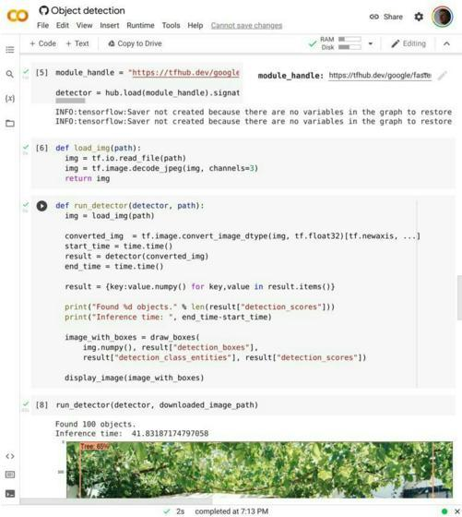
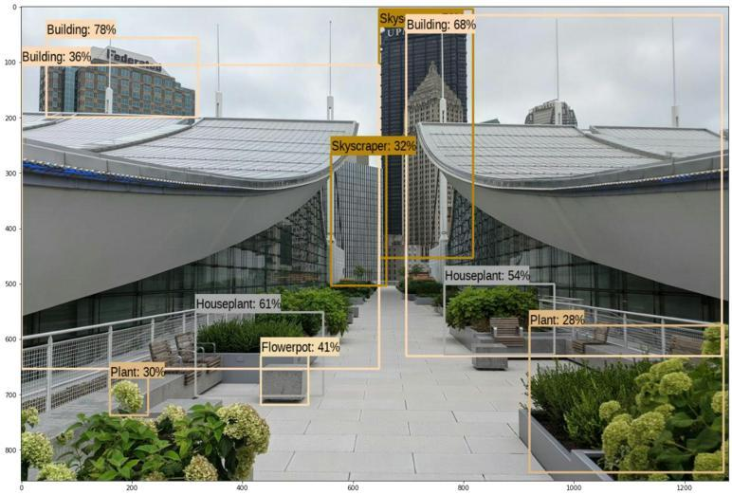
ML Model vs ML System
ML Model
ML System

Slide 11

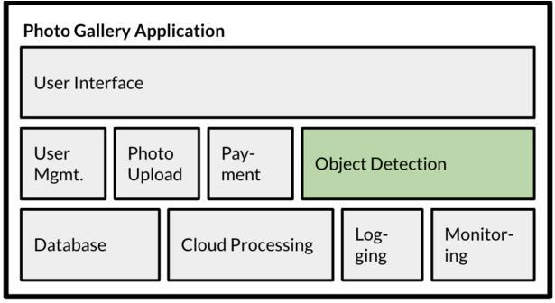
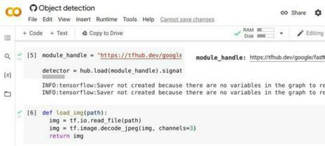
ML Model vs ML System
ML System
ML Model

Slide 12
ML Model vs ML System
Model-Centric View: Focuses on improving the machine learning model by tuning algorithms, features, and hyperparameters to achieve better accuracy.
System-Centric View: Focuses on improving the entire end-to-end system, including data, infrastructure, deployment, and user experience, to deliver reliable real-world performance.

Slide 13
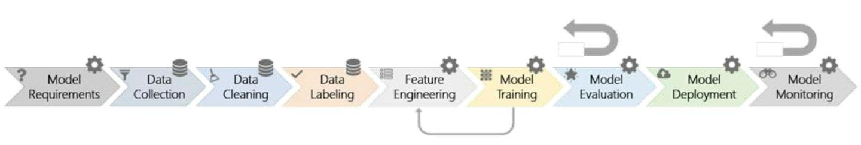
Machine Learning Pipeline

Slide 14
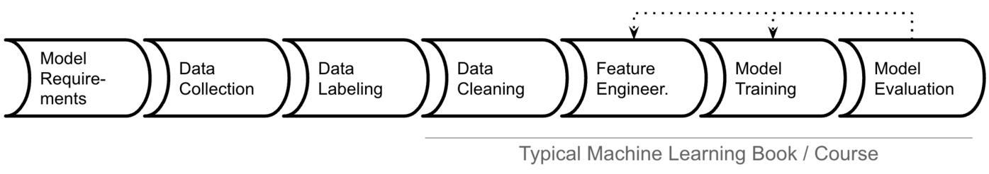
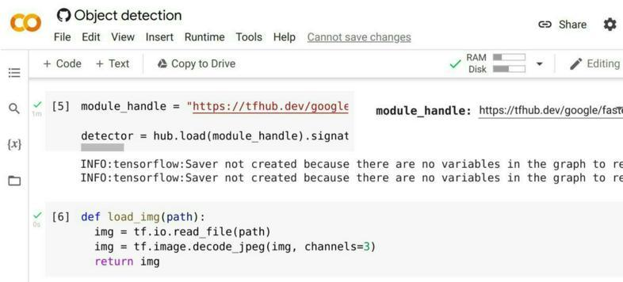
A Closer look…
Focus: building models from given data, evaluating accuracy

Slide 15
Typical ML Pipeline
Static
Get labeled data (data collection, cleaning and, labeling)
Identify and extract features (feature engineering)
Split data into training and evaluation set
Learn model from training data (model training)
Evaluate model on evaluation data (model evaluation)
Repeat, revising features
In production
Evaluate model on production data; monitor (model monitoring)
Select production data for retraining (model training + evaluation)
Update model regularly (model deployment)

Slide 16
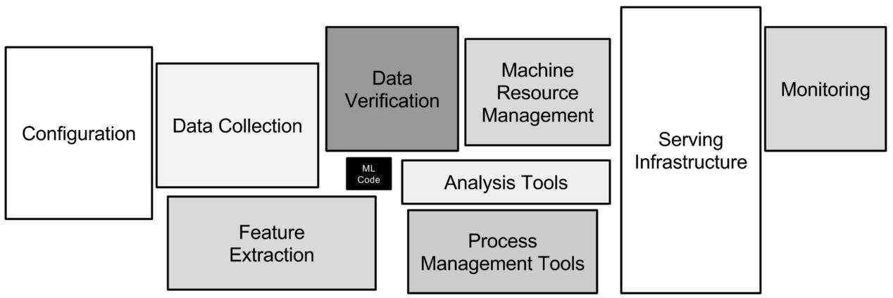
Only a fraction of real-world ML systems is ML code…
ML Code
Sculley, et al. "Hidden technical debt in machine learning systems." NeurIPS 28 (2015): 2503-2511.

Slide 17
ML and non-ML components in a system

Slide 18
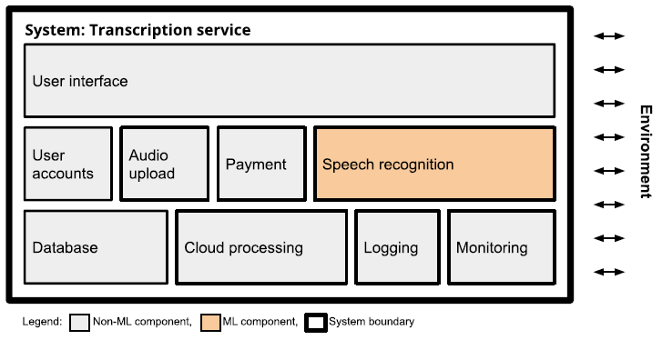
Transcription System: “Speech Recognition” is CORE Functionality

Slide 19
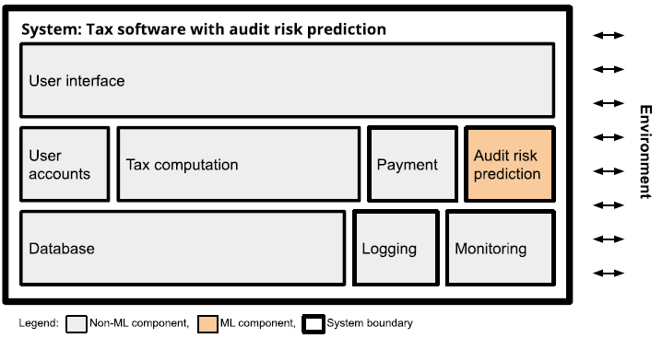
Tax Software: “Audit Risk” Prediction is Auxilliary or Add-on Functionality

Slide 20
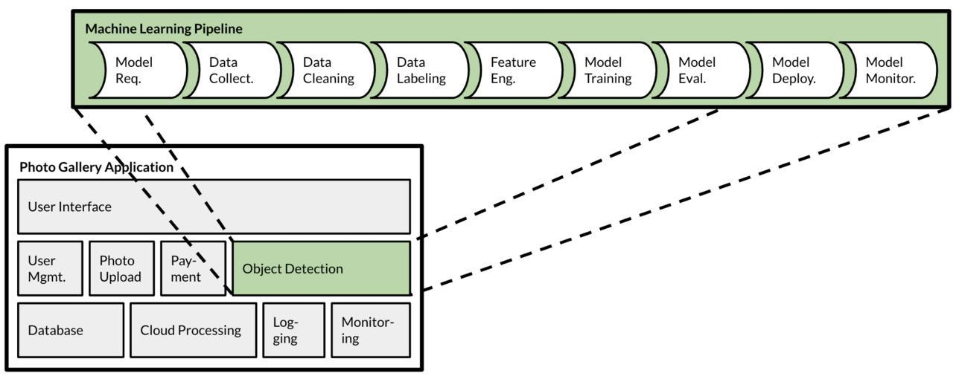
ML is a Component in a System

Slide 21
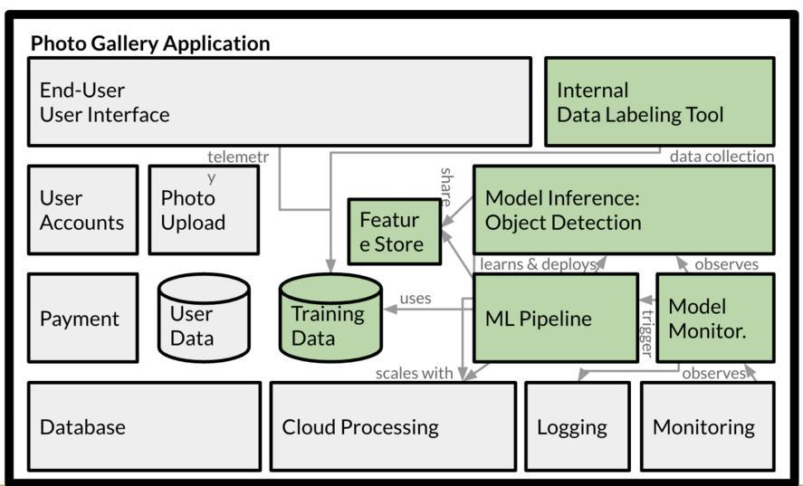
Or Many ML Components Actually

Slide 22
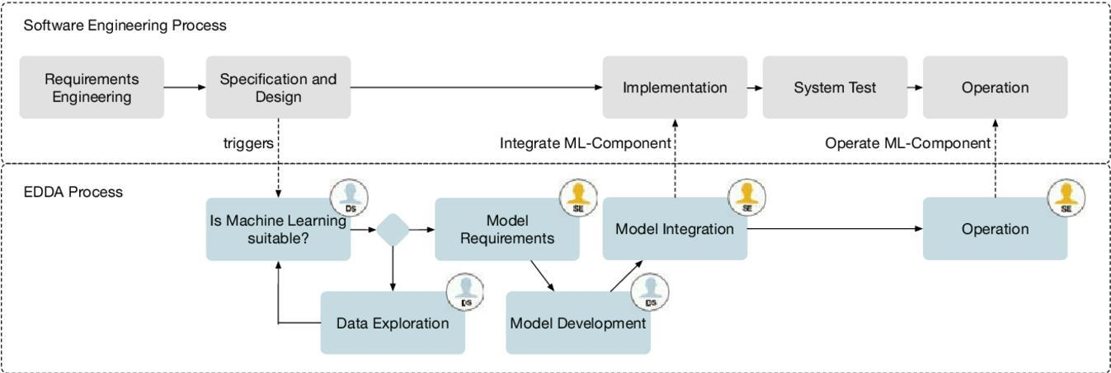
ML Introduces Additional Complexities in Software Systems
Hesenius, Marc, et al. "Towards a software engineering process for developing data-driven applications." 2019 IEEE/ACM 7th International Workshop on
Realizing Artificial Intelligence Synergies in Software Engineering (RAISE). IEEE, 2019.

Slide 23
Systems Thinking
Understand system needs and goals and interactions with environment
Designing components and integrating ML and non-ML parts into a system
Many roles and stakeholders, interdisciplinary endeavour

Slide 24
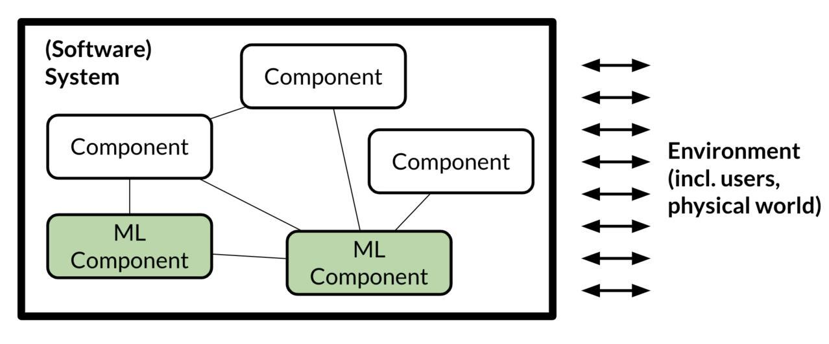
Systems Thinking

Slide 25
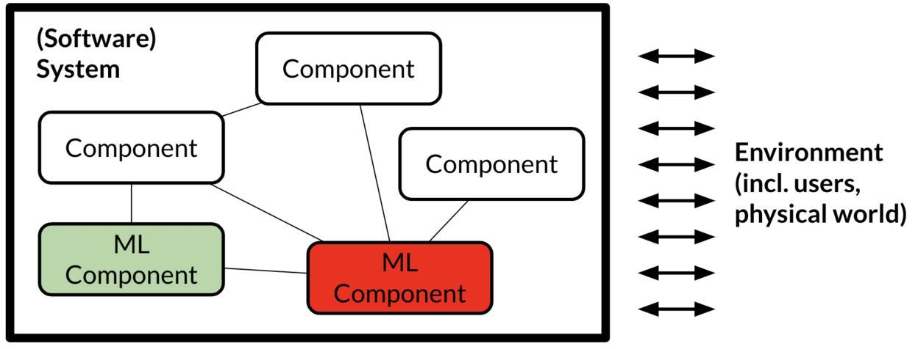
What to do when the ML component makes mistake?

Slide 26
AI Paradigms: Predictive, Generative, and Agentic AI
J. Schneider, "Generative to agentic AI: Survey, conceptualization, and challenges," arXiv preprint, arXiv:2504.18875, 2025. doi: 10.48550/arXiv.2504.18875

Slide 27
Differences
Predictive AI: Uses past data to predict future outcomes.
Generative AI: Creates new content based on learned patterns.
Agentic AI: Acts autonomously to achieve goals using reasoning and tools.

Slide 28
Generative AI
Definition
A system based on a foundation model that generates digital artifacts based on natural user instructions.
Digital artifacts can range from simple binary outputs to complex forms like text, images, and videos.
Natural user instructions are easy for humans to understand and do not require technical knowledge, such as everyday language or visual inputs like photos or sketches.

Slide 29
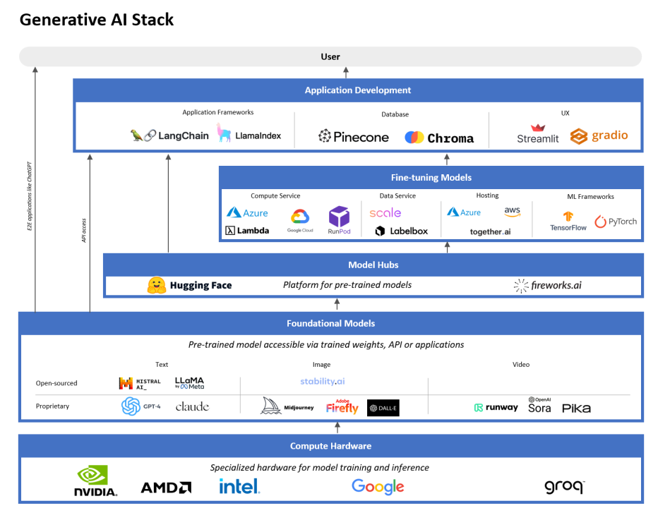
Generative AI Architecture

Slide 30
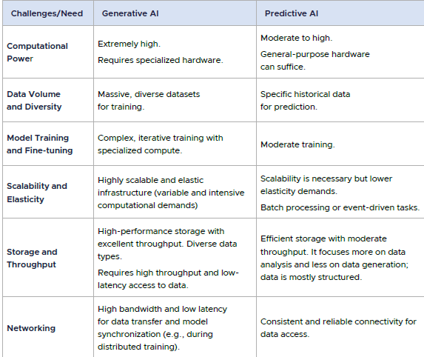
Generative vs Predictive AI
Ref – “Cloud Native Artificial Intelligence”

Slide 31
Agentic AI
Definition 1 [Nvidia]
"Agentic AI uses sophisticated reasoning and iterative planning to autonomously solve complex, multi-step problems.“
Definition 2 [OpenAI]
"Agentic AI systems are AI systems that can pursue complex goals with limited direct supervision"
Definition 3
“A system based on a foundation model that performs tasks potentially yielding artifacts based on natural user instructions, where the system is able to conduct and express complex reasoning including planning and reflection to solve tasks that require interaction with an environment or elaborate tool use”

Slide 32
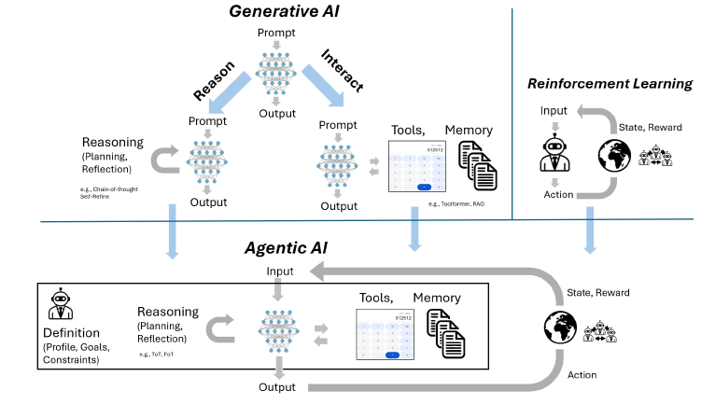
Generative vs Agentic AI
Generative AI: "Tell me what to do, I’ll generate an answer"
Agentic AI: "Give me a goal, I’ll figure out the steps, act, and improve until it’s done"
Generative AI + Reasoning + Tools + Feedback Loops → Agentic AI

Slide 33
Cloud Native ML Systems
Reference R5

Slide 34
Cloud Native ML Systems
Cloud Native technology provides a scalable and reliable platform for running applications.
Advances in AI and ML is steadily rising as a dominant cloud workload.
CNCF defines Cloud-Native as
“Cloud Native technologies empower organizations to build and run scalable applications in modern, dynamic environments such as public, private, and hybrid clouds. Containers, service meshes, microservices, immutable infrastructure, and declarative APIs exemplify this approach.”

Slide 35
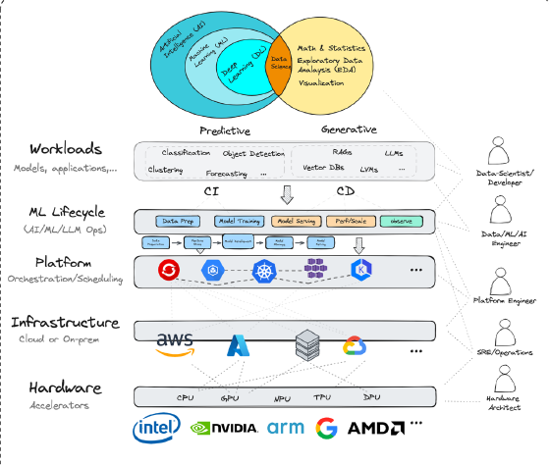
Cloud Native ML Systems

Slide 36
Case Studies
R1, R2 reference materials

Slide 37
Apollo Case Study
R1

Slide 38
Apollo Case Study
The Apollo case study examines how machine learning models are integrated into a large-scale, real-world autonomous driving system.
It highlights that such systems are not built around a single model, but involve multiple interacting ML components combined with traditional software logic.
Apollo, developed by Baidu, serves as a representative example of a complex ML-powered system used in industry.
The study explores how different models handle tasks like perception, detection, and trajectory prediction.
It also shows how these models interact with each other and with code to make real-time driving decisions.
A key focus is on the challenges of integrating, testing, and maintaining such systems.

Slide 39
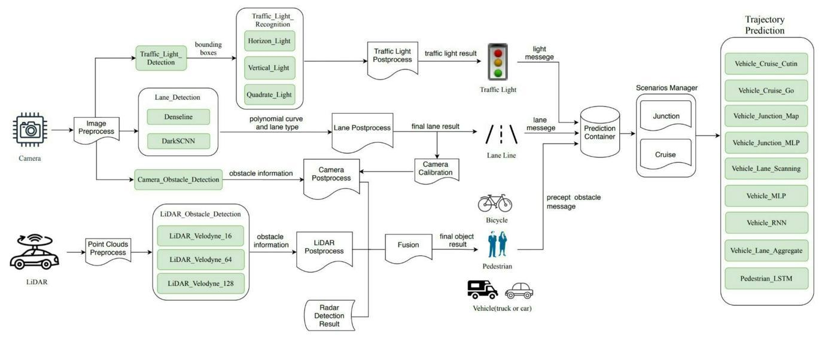

Apollo ML Model
Green boxes represent ML Models
https://www.youtube.com/watch?v=W5mEAmdkt7E

Slide 40
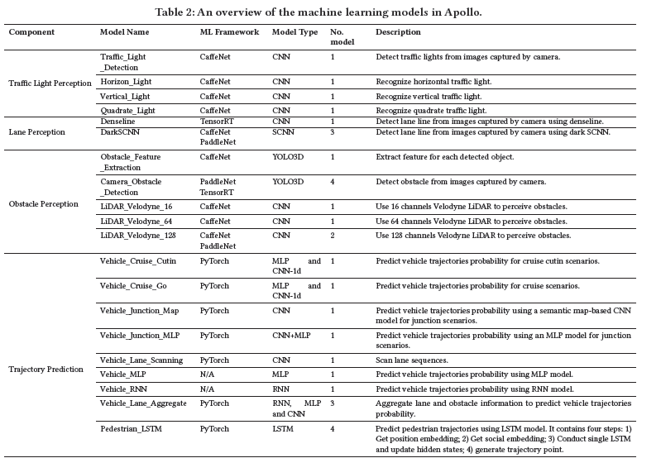
Overview of ML Models in Apollo

Slide 41
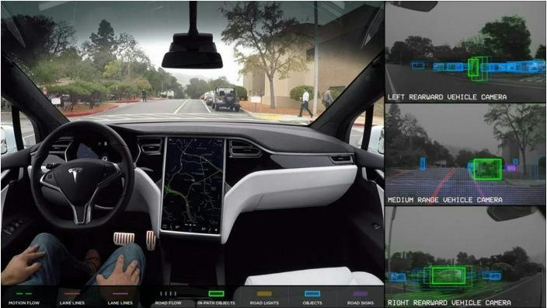
Apollo ML Model

Slide 42
Apollo Case Study
[Integration of ML in Complex Systems]
ML systems ≠ standalone models: Real-world systems integrate multiple ML models + traditional code logic working together.
Large-scale ML architecture: Apollo uses 28 ML models across perception, detection, and prediction tasks.
Model interaction is complex: Outputs of one model often become inputs to others, creating strong interdependencies.
Code plays a critical role: Handles pre-processing, post-processing, validation, and decision logic around ML outputs.
Multi-source data fusion: Combines inputs from camera, LiDAR, radar, and maps to improve accuracy.
Scenario-based model selection: Different ML models are used dynamically based on context (e.g., traffic, road conditions).
Key SE4ML challenges: High system complexity, low test coverage, model maintenance issues, and need for system-level quality assurance.

Slide 43
Microsoft Case Study [Self Study]
R2

Slide 44
Microsoft Case Study
Studies show real-world software teams at Microsoft build AI/ML-based systems using adapted engineering practices.
Proposes a 9-stage ML workflow covering data, model development, deployment, and monitoring.
Highlights that ML development is highly iterative with multiple feedback loops, unlike traditional linear workflows.
Identifies data as the central component, with challenges in data collection, cleaning, labeling, and versioning.

Slide 45
Microsoft Case Study
Shows that ML systems require new roles (data scientists, ML engineers) alongside traditional developers.
Emphasizes integration of ML workflows into Agile/DevOps practices for scalable development.
Identifies key challenges: data management, model debugging, deployment, tooling, and system integration.
Introduces a process maturity model to assess how effectively teams develop and manage ML systems.

Slide 46
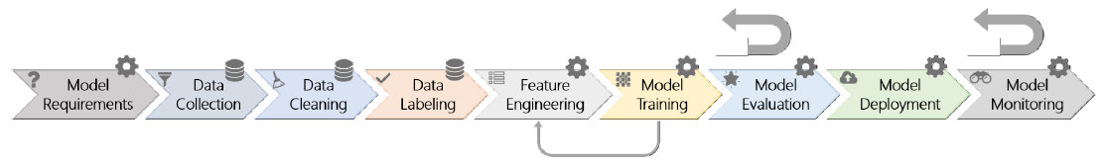
9 stages of ML Workflow
Model Requirements: Designers decide which product features can be solved using ML and select appropriate model types for the specific problem.
Data Collection: Teams gather existing datasets or collect new data, often combining generic datasets with domain-specific data using transfer learning.
Data Cleaning: Noisy, inaccurate, or irrelevant data records are removed to improve data quality before training.
Data Labeling: Ground truth labels are assigned by engineers, domain experts, or crowd workers to enable supervised learning (or rewards for RL).
Feature Engineering: Relevant features are extracted and selected; in some models like CNNs, this step is implicit and merged with training.
Model Training: Models are trained and tuned using cleaned, labeled data and selected features.
Model Evaluation: Models are evaluated using predefined metrics and, in critical cases, additional human validation.
Deployment: The trained model’s inference code is integrated and deployed into the target application or system.
Monitoring: The deployed model is continuously monitored in real-world settings to detect errors, drift, or performance issues.

Slide 47
Adoption of Software Engineering Practices in ML
Integration with Agile/DevOps: ML workflows are embedded into existing Agile and DevOps processes for continuous development and deployment.
End-to-end ML pipelines: Automated pipelines handle data, training, evaluation, and deployment as a unified engineering workflow.
Data engineering as core SE activity: Data collection, cleaning, versioning, and management become central engineering tasks (not just preprocessing).
Experimentation-driven development: Iterative experimentation (models, features, data) replaces traditional deterministic development cycles.
Versioning beyond code: Both models and datasets are versioned and tracked with provenance metadata.

Slide 48
Adoption of Software Engineering Practices in ML
Continuous evaluation & monitoring: Models are continuously evaluated using metrics, real-world feedback, and human-in-the-loop validation.
Model debugging & interpretability: SE practices extend to debugging model behavior, requiring explainability and visualization tools.
Cross-functional teams: Inclusion of data scientists, ML engineers, and domain experts alongside traditional developers.
Handling system-level complexity: ML components are tightly coupled (“entangled”), requiring system-level testing and integration strategies.
Process maturity for ML: Adoption of maturity models (similar to CMM) to assess automation, consistency, and continuous improvement in ML workflows.

Slide 49


